Slide 1

North East University Bangladesh
Department of Computer Science and Engineering
He & She Mart
By
Anwar Hossain
Reg. No: 170303020102
B.Sc.(Engg.) in CSE
5th year 1st semester
Supervised By
Pranta Sarker
Lecturer
Department of Computer Science and Engineering

Slide 2
Noobs Codeware
A Project submitted to the Department of Computer Science and Engineering, North East University Bangladesh, in partial fulfillment of the requirements for the degree of Bachelor of Science in Computer Science and Engineering.
By
Anwar Hossain
Reg. No: 170303020102
B.Sc.(Engg.) in CSE
5th year 1st semester
Supervised By
Pranta Sarker
Lecturer
Department of Computer Science and Engineering

Slide 3
Recommendation Letter from Project Supervisor
This student, Anwar Hossain, whose project entitled “He & She Mart”, is under my supervision and I agree to submit for examination.
Signature of the Supervisor ：
Pranta Sarker Lecturer
Department of Computer Science and Engineering North East University Bangladesh

Slide 4
Qualification Form of B.Sc. (Engg.) Degree
Student Name： Anwar Hossain Project Title：He & She Mart
This is to certify that the thesis is submitted by the student named above in January 2022. It is qualified and approved by the following persons and committee.
Head of the Dept.
Tasnim Zahan
Assistant Professor & Head Department of CSE
North East University Bangladesh
Supervisor Pranta Sarker Lecturer
Department of CSE
North East University Bangladesh

Slide 5
ABSTRACT
He & She Mart aims to explore e-commerce business that will ensure the special branches of e business. He & She Mart is an electronic commerce is process of doing business through computer networks. A person sitting on his chair in front of a computer can access all the facilities of the internet to buy or sell the products. I have added some special parts of e-commerce site. For instance- It will have the following parts-Log In, Sign Up, Add Products, List of produces, Delete Products, Image update, Search, Cart, Invoice, Shipping Information etcetera. I have used Laravel, MySQL, React, React-Bootstrap and API.
Keywords: E-commerce, Login, Sign up, Products, Cart, Laravel, API and React.

Slide 6
Table of contents
INTRODUCTION
Objective
Drawbacks of the existing system
Features
BACKGROUND STUDY
Codeforces
Virtual judge
Stopstalk
CP-Algorithms
1
1
2
3
6
9
10
FEASIBILITY STUDY
User and Admin Site Feasibility
Technical Feasibility
Financial Feasibility
Resource Feasibility
Risk Feasibility
Developer’s Site Feasibility
Technical Feasibility
FinancialFeasibility
Resource Feasibility
Risk Feasibility
11
11
11
11
12
12
12
12
12
12
REQUIREMENT ANALYSIS
Requirements of the system
Architectural Requirements
Structural Requirements
Behavioral Requirements
Functional Requirements
Non-functional Requirements
Performance Requirements
Design Requirements
13
13
13
13
13
13
14
14

Slide 7
APPLICATION DIAGRAM
Activity DiagramEntity
Use Case diagram
Relationship Diagram
15
16
17
USER INTERFACE DESIGN
Login
Sign Up
Home
Admin Panel
Problem Set
Problem page
Problem Overview
Contest
Live Rank
18
19
20
21
22
23
24
25
26
27
28
29
30
31
32
33
34
Profile
Update Profile
Other OJ Statistics
Tutorial
Updates
Todo List
Contact Us
About Us
TOOLS USED
Overview
Hardware
Operating System
Sofware
Language
Compatibility
35
35
35
35
35
35
FUTURE WORK CONCLUSION REFERENCES
36
37
38

Slide 8
Acknowledgment
First of all, I am very grateful to the Almighty Allah for his mercy. I am highly grateful to my supervisor Mr. Pranta Sarker for his guidance as well as for providing necessary suggestions regarding the project and also for the support in completing the full of the project. We would like to express our gratitude towards the authors of the resources available on the internet from which we have learned and have taken help for our project.

Slide 9
Chapter 1
INTRODUCTION
He & She Mart is an e-commerce site where has some important parts which is be very convenient to purchase a product for a user. Admin can add and delete products. There are no physical market places and the entire process and selling goods, take place online or electronically. User can cart more than one product what they preferred.
Objective
Increasing sales volume is the primary goal of every business, and this factor is affected by various factors. So, getting a reliable solution for not decreasing sales is E-commerce. It is because you are constantly gaining customers online when you appear on the top search results. It is only possible when your business is running on an E-commerce platform. So, the ultimate solution to increase sales is E-commerce.
Drawbacks of the existing system
There are already very well known 6-7 e commerce sites on internet. User may feel uncomfortable in my system comparing to the existing popular e commerce site as those are heavily used.
If I consider my project with special branches like products categories, branding categories user may get the such opportunities.
Using two APIs from UVa & Codeforces in our system causes slow loading and opening of the webpage.
As this is a special-purpose web application so definitely all classes of internet users won’t use this. We are only targeting people from programming backgrounds.

Slide 10
1.3 Features
Conducting the registration through filling up registration forms.
A straightforward login system.
Every webpage containing the only necessary information, no unnecessary stuff.
Profile viewing for every user(his/her own and others also).
Updating the profile information in need.
Solve different categorized problems with three several difficulty levels (Easy, Medium & Hard).
A global rank list of all users sorting by their rating.
A to-do list for every user to add problems and keep track of later solving.
Participating in contests(Public and Password protected).
A public rank list for every contest.
Set different types of contests with a short and long duration.
A global live status showing the verdict of all problems submitted, updating within seconds.
A tutorial section where programmers can learn new tools, algorithms.
A dedicated announcement section to easily interact with the latest updates.
Users can see his/her own and also other user statistics of two popular online judges Codeforces and Uva.
A self-written compiler API in PHP to compile and run C, C++, Java & Python code for checking and providing verdict for each submission.
An admin panel to manage, update, create problems, tutorials, and announcements.
Discussion section for each problem and contest.
Request to set a problem or publish a tutorial.
Responsive user interface for any layout and devices.
2

Slide 11
Chapter 2
BACKGROUND STUDY
For background study, we have visited almost all the online judge’s websites out there. We have also visited a few tutorial websites for finding the ideas. We analyzed those websites for getting a better understanding. We are focusing on developing such a website where competitive programmers can practice programming problems and also participate in occasional contests. There are already 15+ popular websites for practicing competitive programming problems. We are highly inspired by V irtual judge and the most popular website Codeforces.
We visited various online judges to being known about the UI and other key features.
We discuss with competitive programmers what features they like to be in an online judge.
We note down all the features collected from various online judges.
We identified common-uncommon and missing features to chose the best for us.
Codeforces
Nowadays it is the most popular & functional site for programmers on the planet. It arranges contests on regular basis as well as has the biggest source of programming problems. We are highly inspired by the features and design of the website.
Features we have adapted from codeforces:
Problem set
Contest
Create contest
Live status
Global rank
Announcement
3

Slide 12
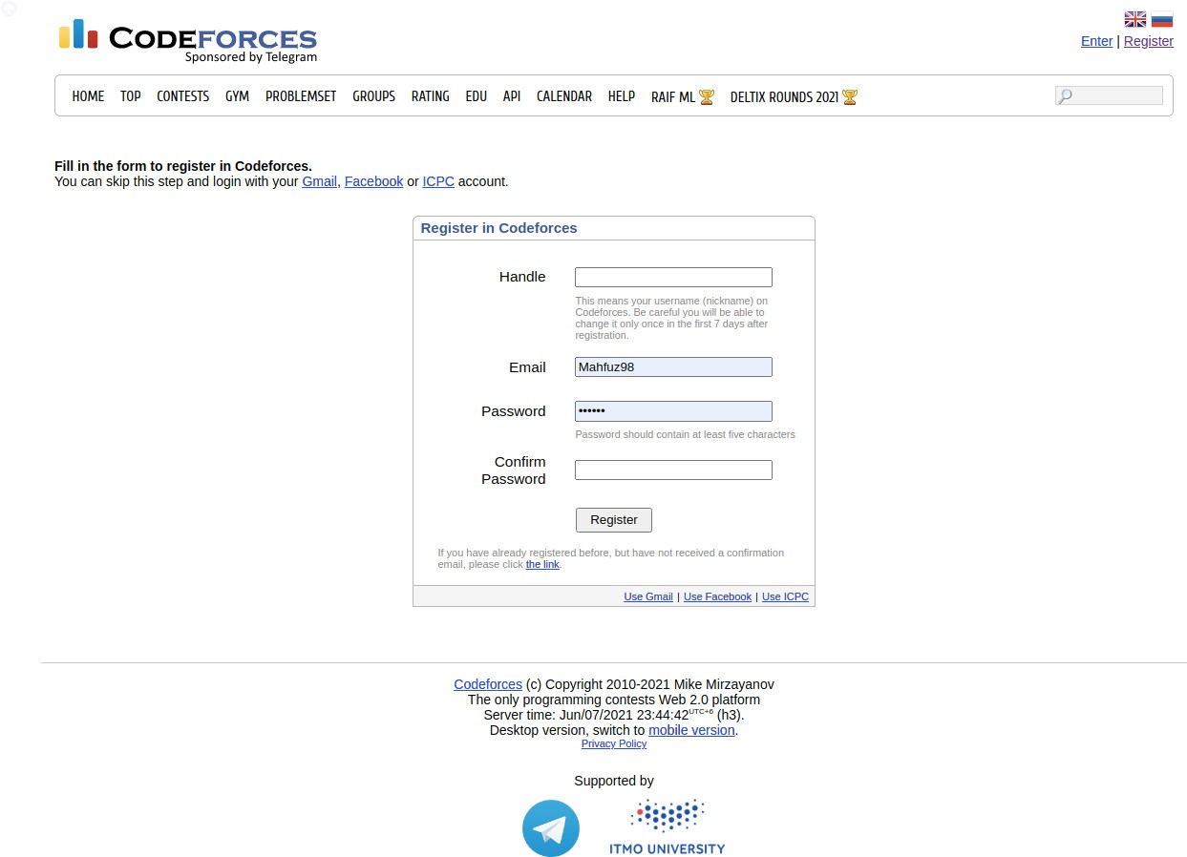
Features we have added that are not in codeforces:
Todo list
Tutorial
Problem suggestion to solve
For design purposes, we have taken ideas from codeforces.
i. User registration page
4

Slide 13
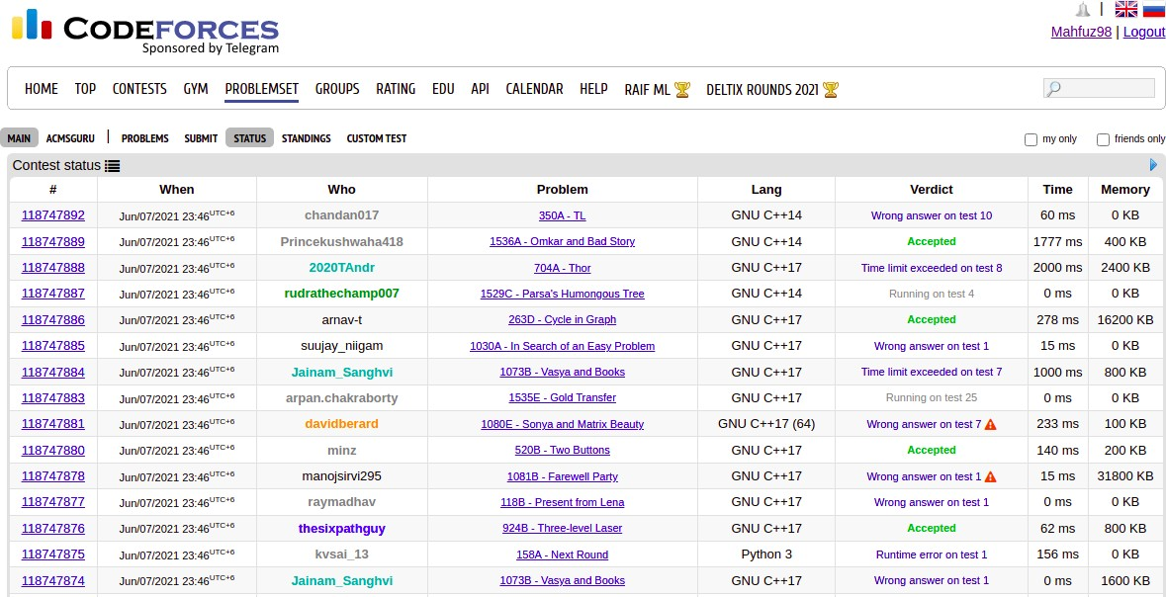
ii. Live status page
5

Slide 14
Virtual judge
Virtual judge is the most popular online judge for quick contest settings. It borrows problems from other sources and provides users an easy way to gather and organize the contest. Most of the University and programming
community use virtual judge for practice contest setting regularly.
Features we have adapted from virtual judge:
Problem set
Contest
Create contest
Live status
Tutorial
Features we have added that are not in virtual judge:
Todo list
Announcement
Set problem
Problem suggestion to solve
Also for design purposes, we have taken ideas from this site. Here are some of them below:
6

Slide 15
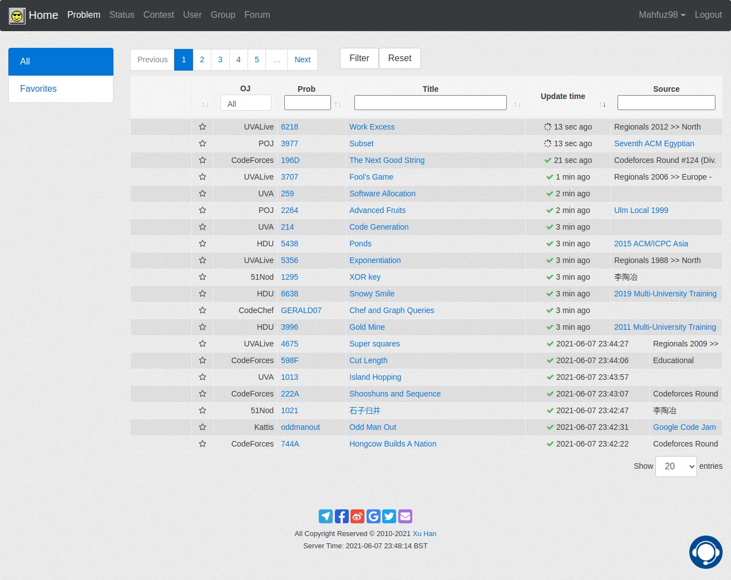
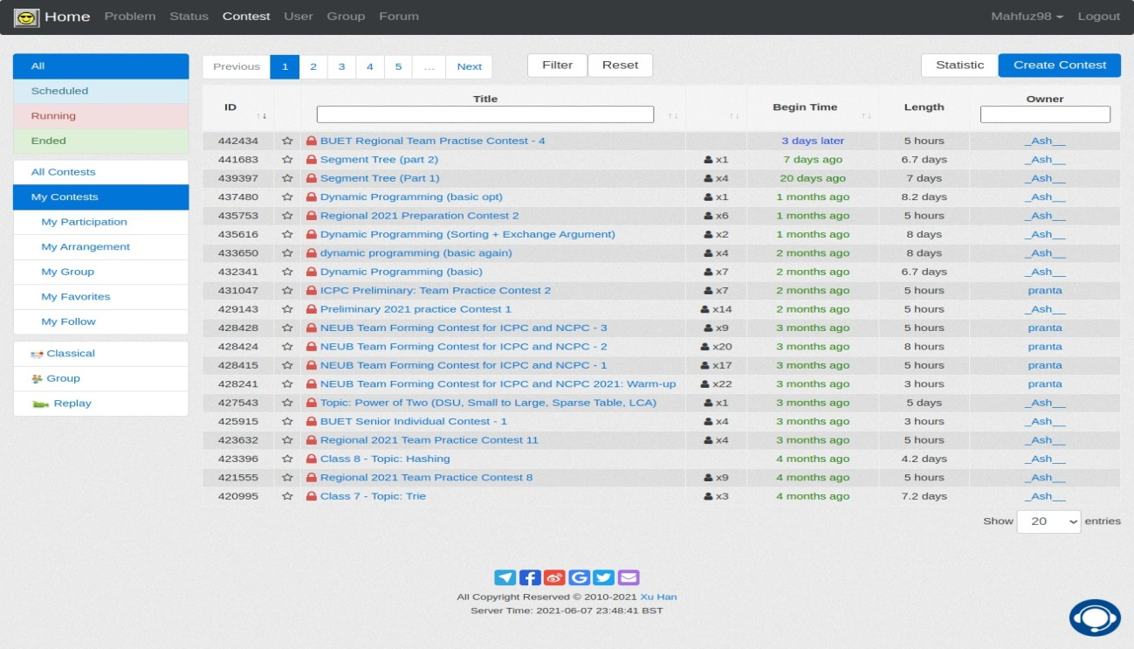
i. Problem set page
ii. Contest list
7

Slide 16
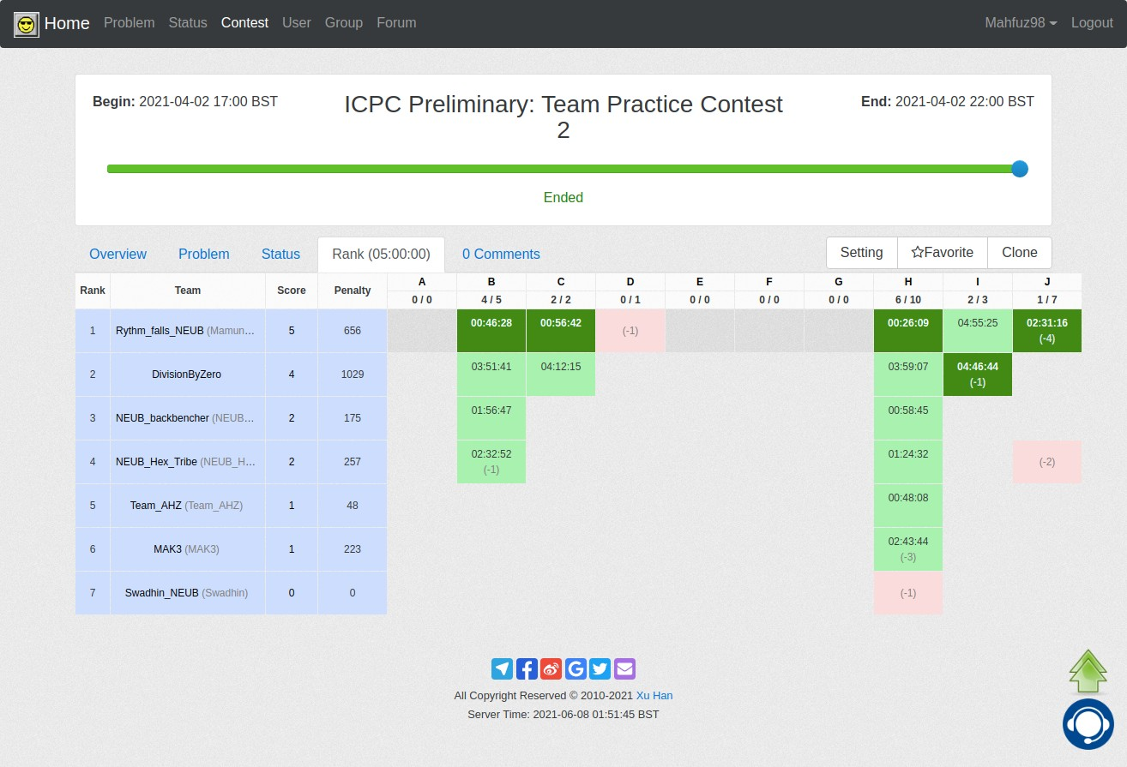
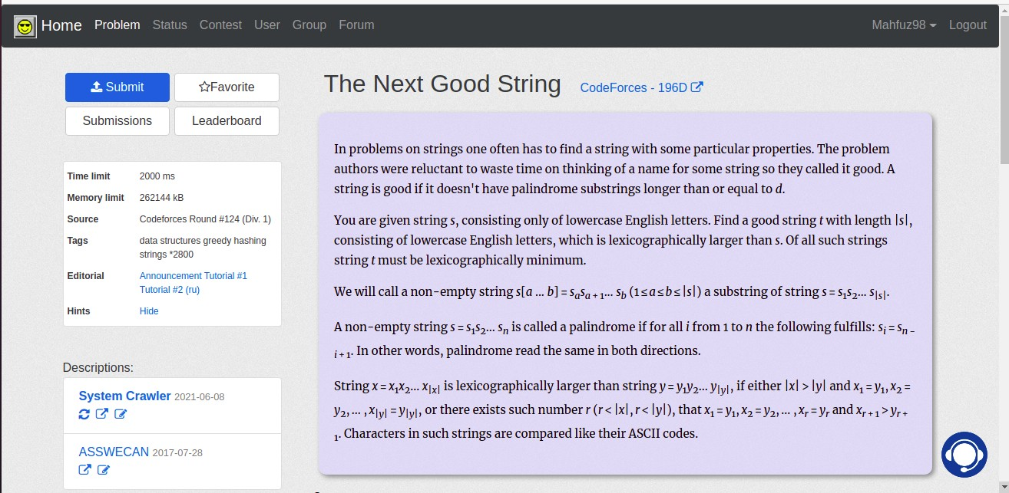
iii.
Contest overview
iv. Problem page
8

Slide 17
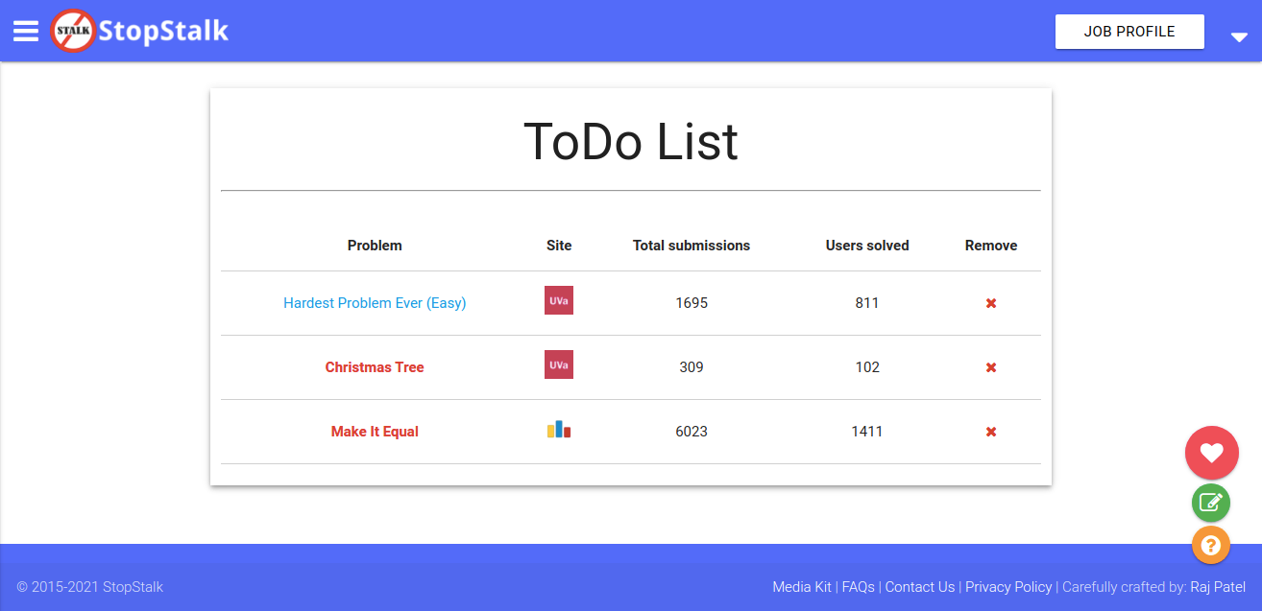
2.3. Stopstalk
Stopstalk is a special website where a user can register and provide his/her all online judges username to keep updated with the performance of his/her own as well as friends ensuring the number of solves, submissions on several online judges.
This site is not an online judge, so directly we can’t adopt anything but there is a feature of todo list which we think very much helpful to users.
Todo List
9

Slide 18
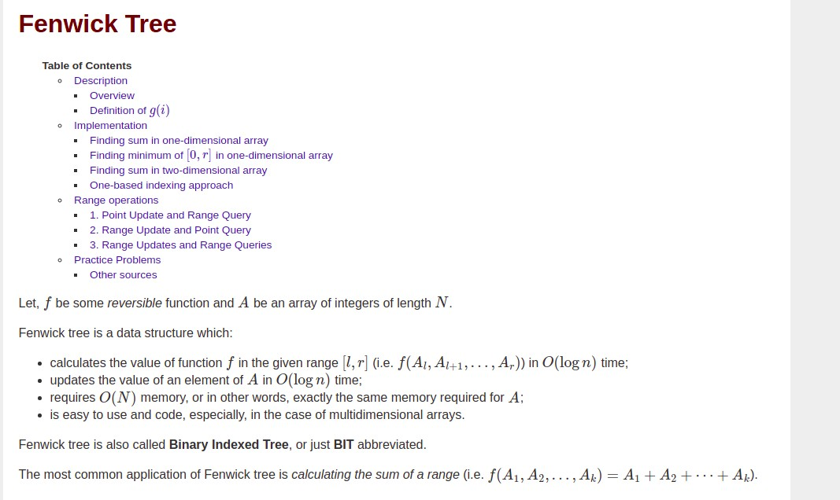
2.4. CP-Algorithm
CP Algorithm is a tutorial blog website where we find different kinds of tutorials about data structures, math,
algorithms. Very few resources are available on the internet as helpful as that. We just visited the site for an idea but not adapting or implementing anything same to that.
A tutorial on Fenwick Tree
10

Slide 19
Chapter 3
FEASIBILITY STUDY
The Feasibility study can be divided into two sites:
User and admin site
Developer’s site
User and Admin Site Feasibility:
Technical Feasibility:
For visiting or using this website, users need a computer with the following hardware-
RAM: 2 GB (min.)
Storage: 32 GB (or above)
Consistent internet connection
Financial Feasibility:
For this application, some amounts will be spent like:
Internet Bills
This website is free of use, User only need to pay their internet connection bill to browse ou
Resource Feasibility
Resources required for using these websites:
Desktop / Laptop / Tablet
Internet connection
11

Slide 20
Risk Feasibility:
Users will get all facilities that are needed for this website.
Users will get all the requirements to use this website
Developer’s Site Feasibility:
Technical Feasibility:
This web application will be developed by the required web technologies environment and cooperative tools. For this the hardware needs:
Minimum 4GB of RAM
Minimum 64 GB of Storage
Dual-Core Processor
Financial Feasibility:
The assessment involves a cost analysis. So this project is financially feasible.
Resource Feasibility:
Resources that are needed like:
Laptop / Desktop
Smartphone
Risk Feasibility:
The tools which are needed to develop the project are all available and free source to use.
The project is an 8-month project. We have divided our work into several sections like frontend designing, backend development, API integration, etc. We hope that we can complete this project without any trouble.
12

Slide 21
Chapter 4
REQUIREMENT ANALYSIS
We have done our requirement analysis part with the following steps:
Visited different ecommerce site
Observed core functionality of each ecommerce site
Observed various requirements for ecommerce site
Analyzed software requirements specification (SRS)
Architectural requirements: We analyzed architecture requirements to structure and organize requirements in such a way that the requirements are stable, usable, adapt to changes, and are elegant. When a requirements architecture is sound, it helps facilitate the better design of the system it attempts to describe. When a requirements architecture is faulty, it can cause problems.
Structural requirements: We analyzed structural requirements to know identifying the necessary structure of our system.
Behavioral requirements: We analyzed behavioral requirements to know identifying the necessary structure of our system.
Functional requirements: Functional requirements mainly explain what has to be done by identifying the necessary task, action, or activity that must be accomplished:
Login: User access via providing email and password
Sign up: Register with unique email and password
Cart: Add preferred products
Checkout: Overall calculations of added products on carts
Making website mobile friendly: Users enable to use in any smart device-responsib
Product attributes: Product attributes will include various product characteristics, and the development agency should know about them to implement the corresponding features.
Non-Functional requirements: Non-functional requirements are requirements that specify criteria that can be used to judge the operation of a system, rather than specific behaviors.
13

Slide 22
Reliability: The system is available on the user’s needs, can work properly and also, ensure security for the user information. Every registered user account will be password protected.
Usability: The system should be supported by all kinds of the browser, device, and also Operating System.
Performance: The system will be optimized and can perform better on any web browser.
User interface: The UI will be user-friendly & easy to use.
Data protection & Security: We will ensure no data loss and provide strong security about user data.
Performance requirements: As we are still working on this project performance measurement is not possible but we will try to provide all the effort to make it perform better
Design requirements: We have analyzed all the design requirements that needed. For designing, coding, building & running all the features we will use the necessary web technologies.
14

Slide 23
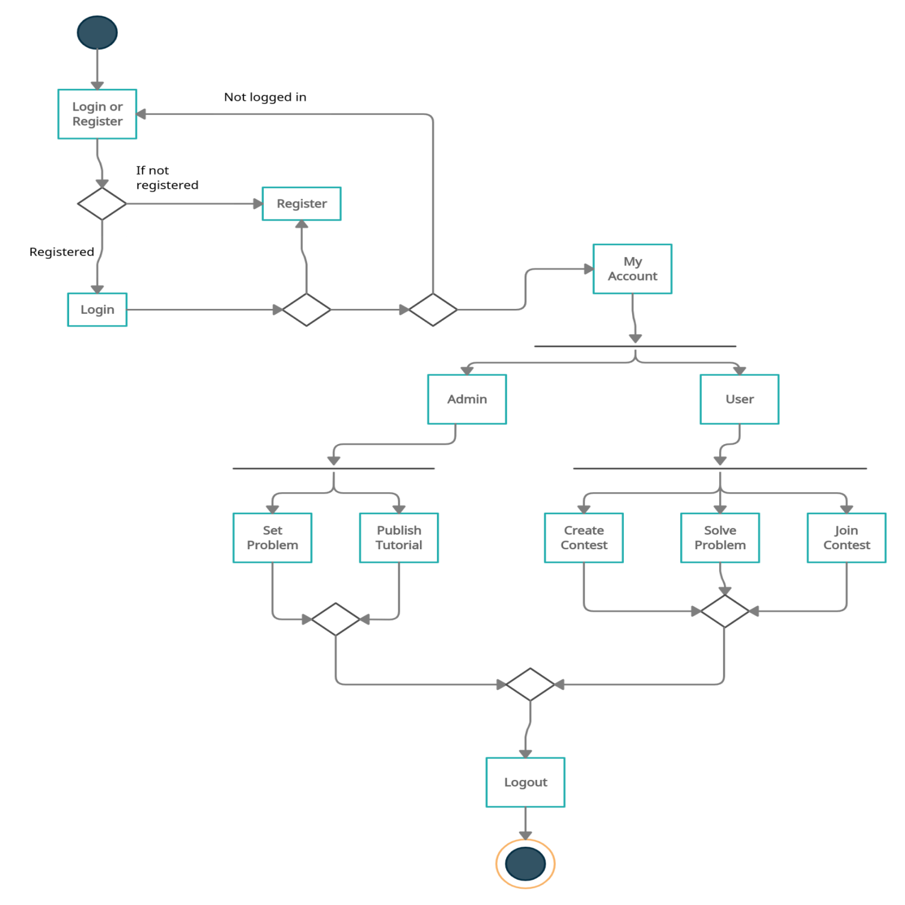
Chapter 5
APPLICATION DIAGRAM
5.1 Activity Diagram

Slide 24
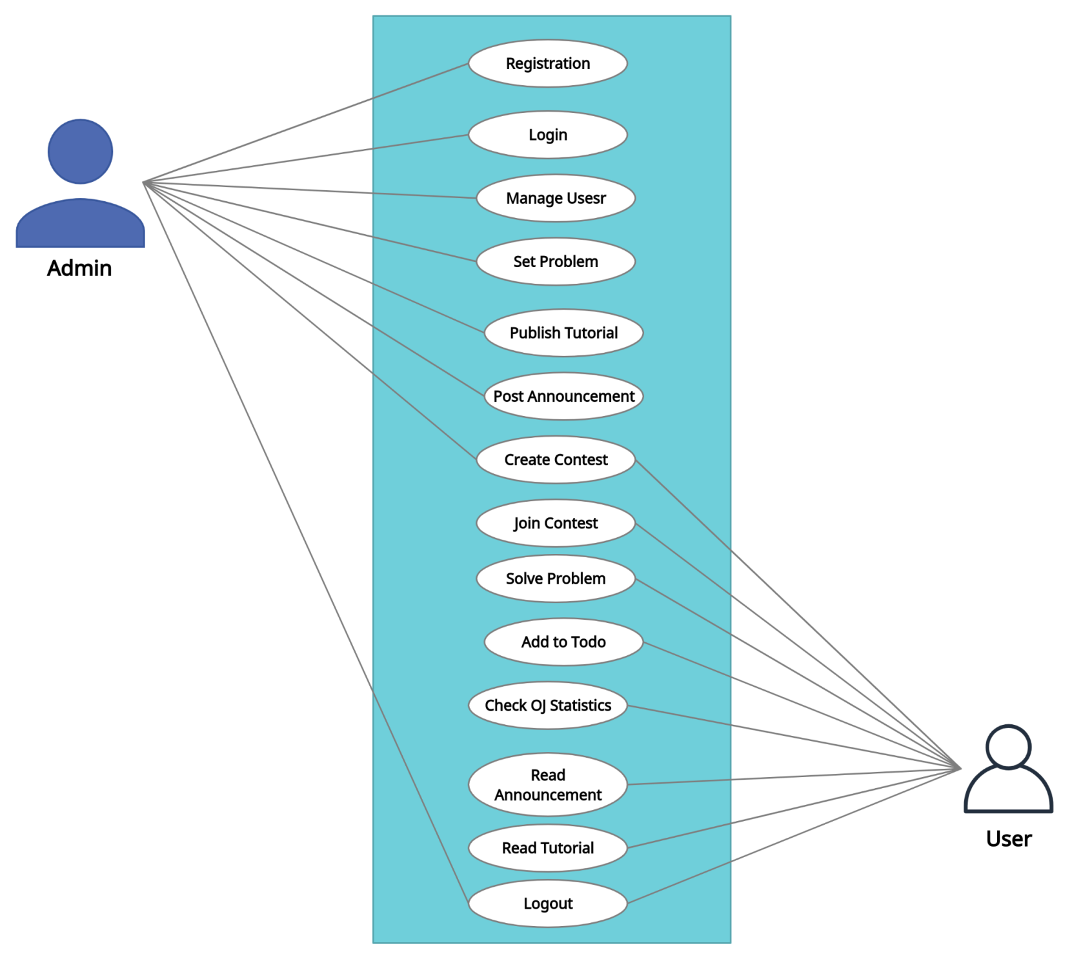
5.2 Use Case diagram

Slide 25
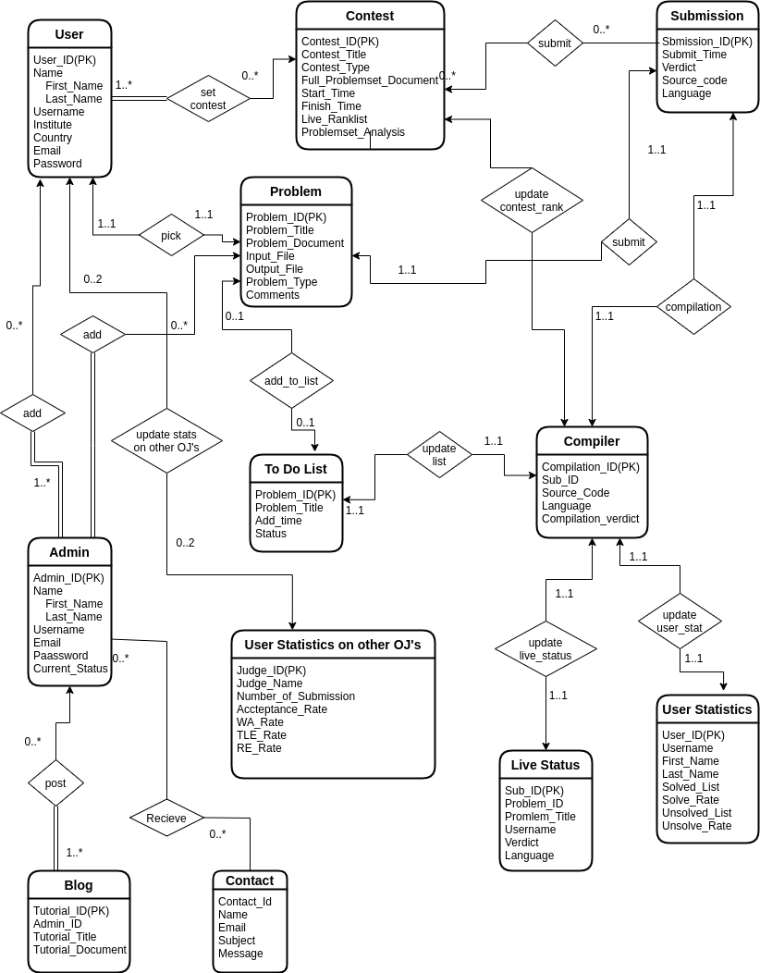
5.3 Entity Relationship Diagram

Slide 26
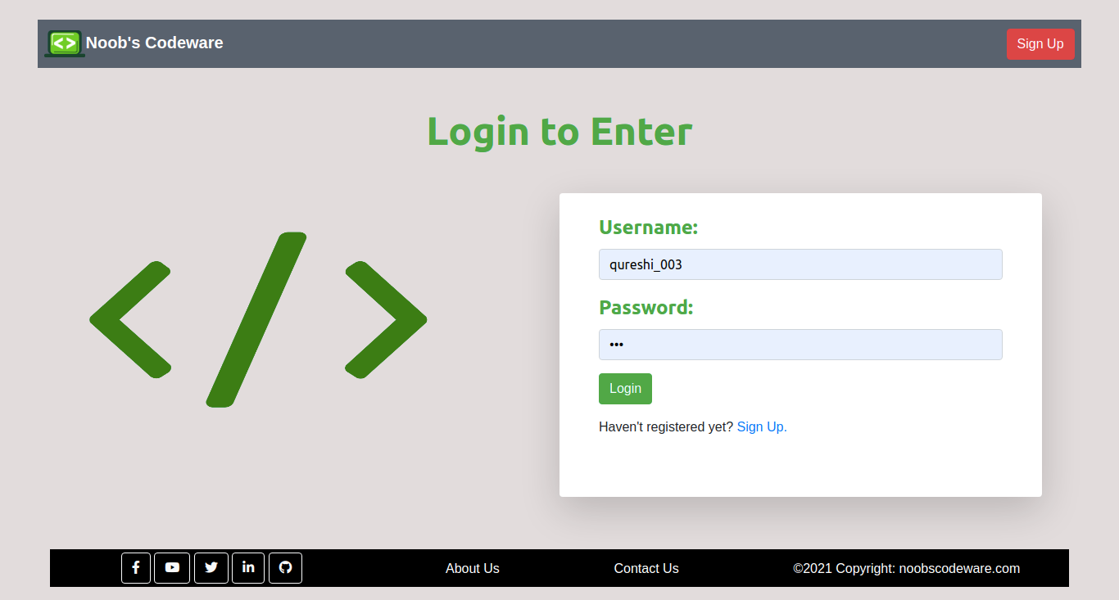
Chapter 6
USER INTERFACE DESIGN
6.1 Login
Fig 6.1: User login
This is our login page. A straightforward login system where users have to enter his/her username and password to log into the system. Email address is also acceptable on the username field.

Slide 27
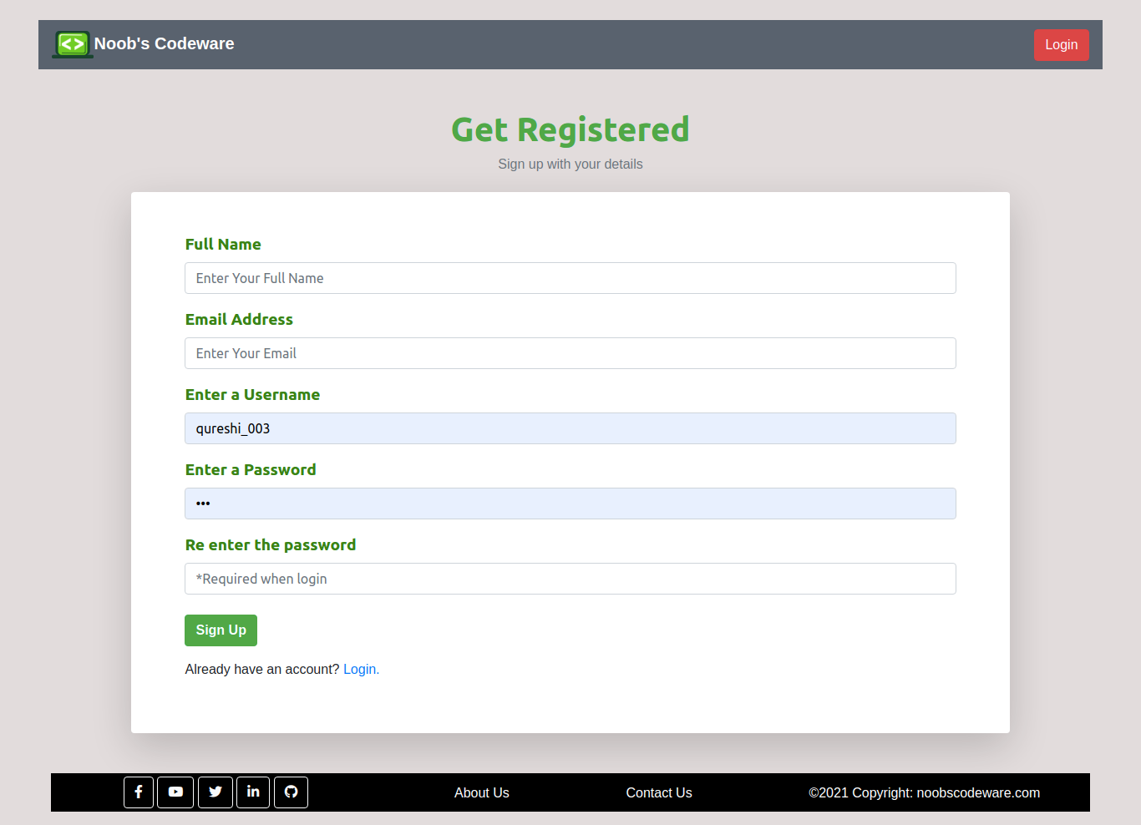
6.2 Sign Up
Fig 6.2: User sign up
The registration process is very easy. Users just need to put a name, email, a unique username for unique identity, and a password for security purposes.

Slide 28
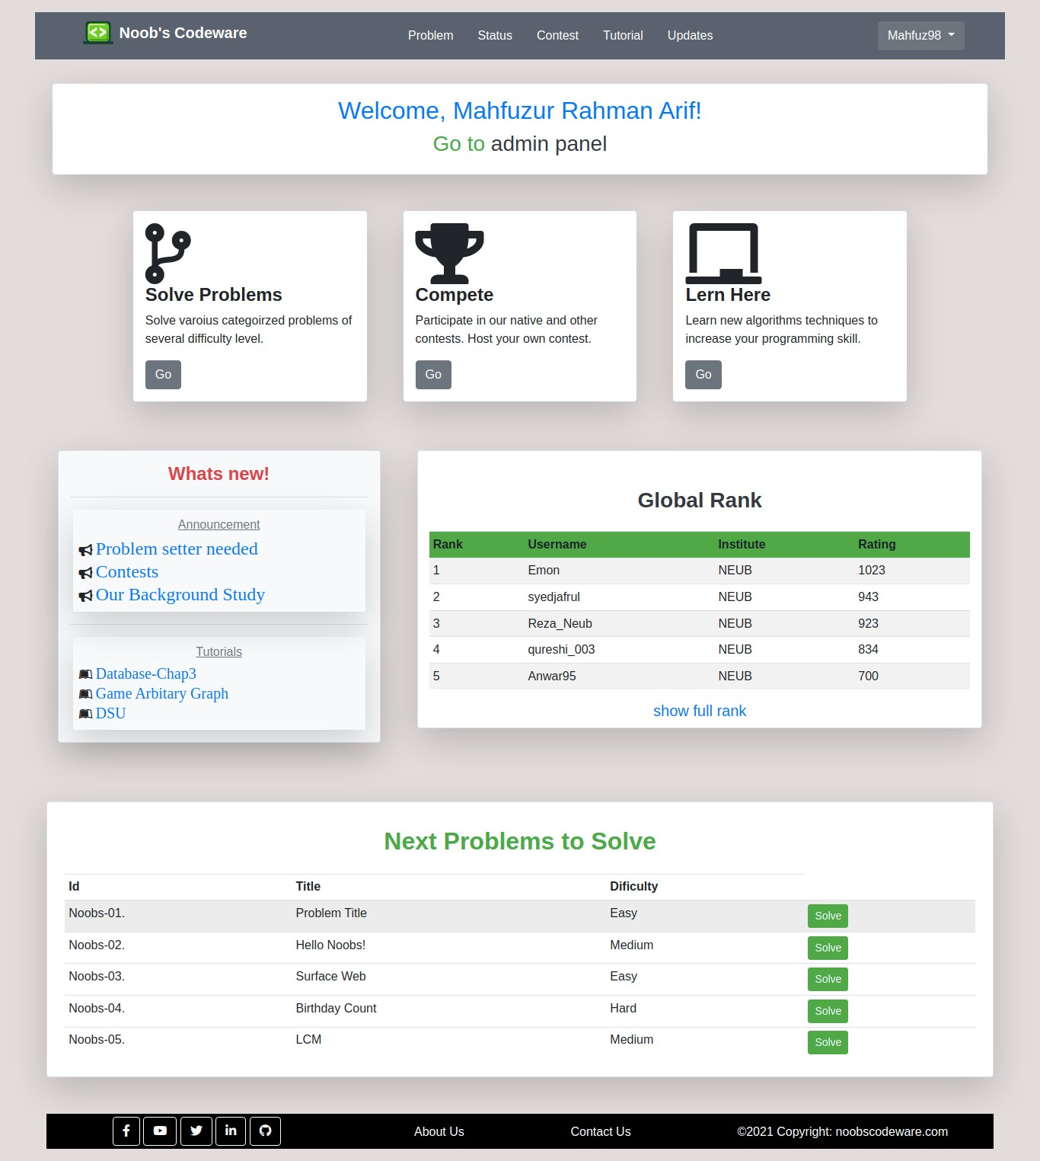
6.3 Home
Fig 6.3: Homepage
This is our homepage with all the necessary structure and information and easy navigation for starting a convenient workflow.

Slide 29
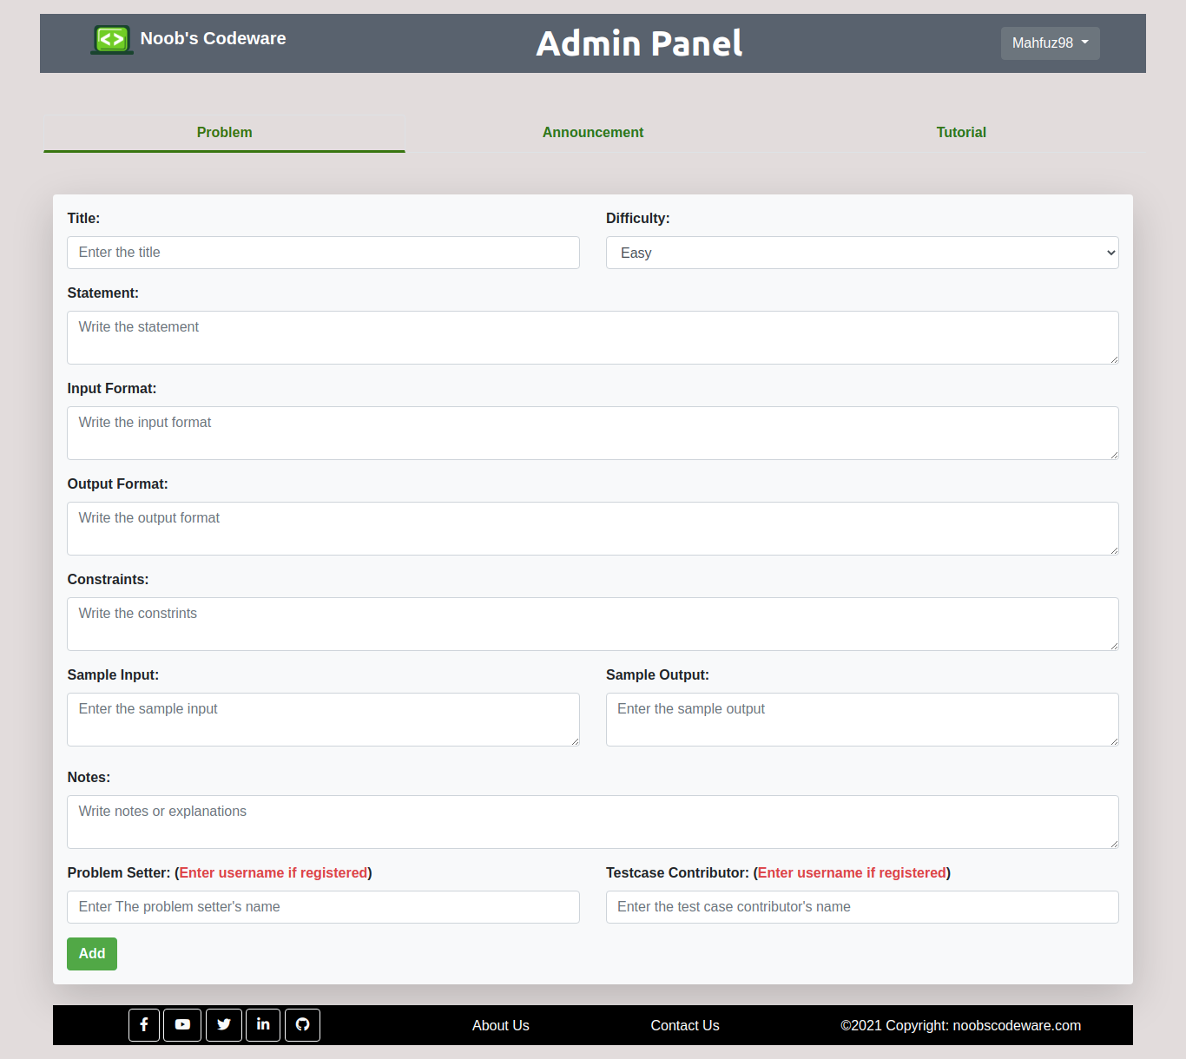
6.4 Admin Panel
Fig 6.4: Admin panel
This is only accessible by admins. Admin can add problems, publish a tutorial or post an announcement.

Slide 30
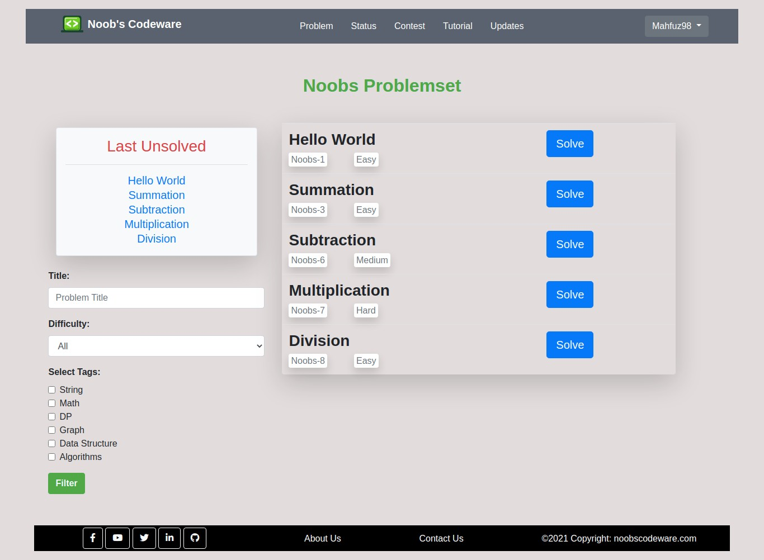
6.5 Problem Set
Fig 6.5: Problem set
Problem set is where all the problems are organized. Users can pick and solve problems easily here.

Slide 31
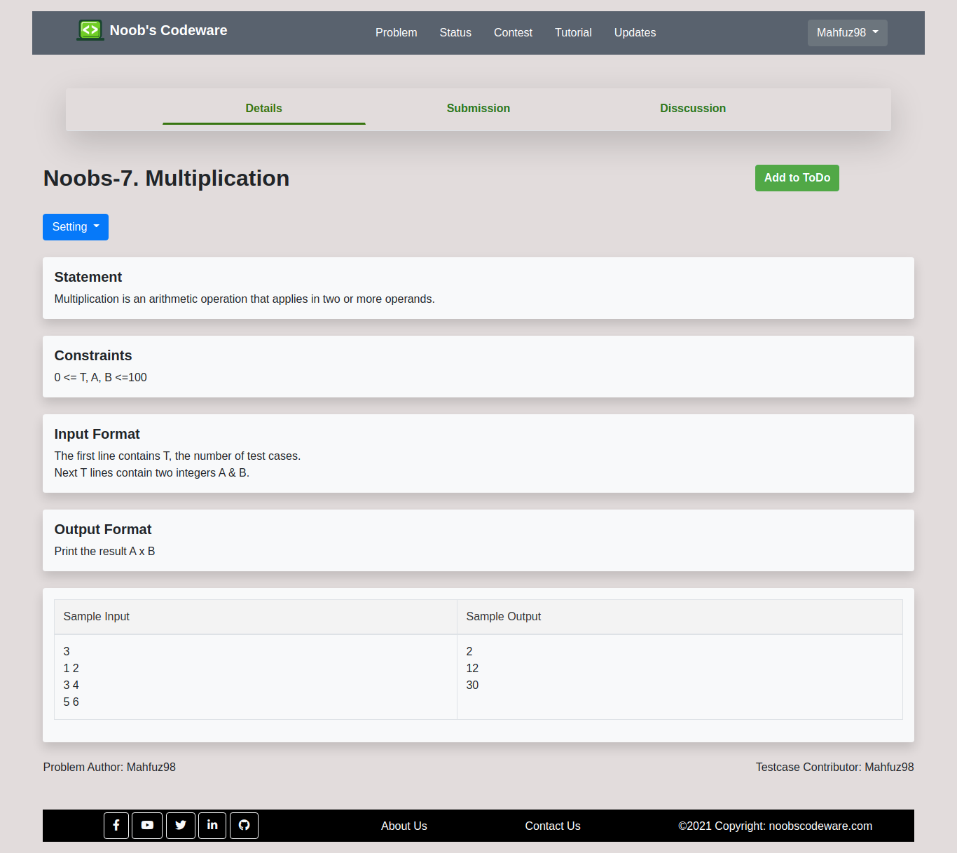
6.6 Problem page
Fig 6.6: Problem
This page simply shows a problem description, submission history, discussion about that problem.

Slide 32
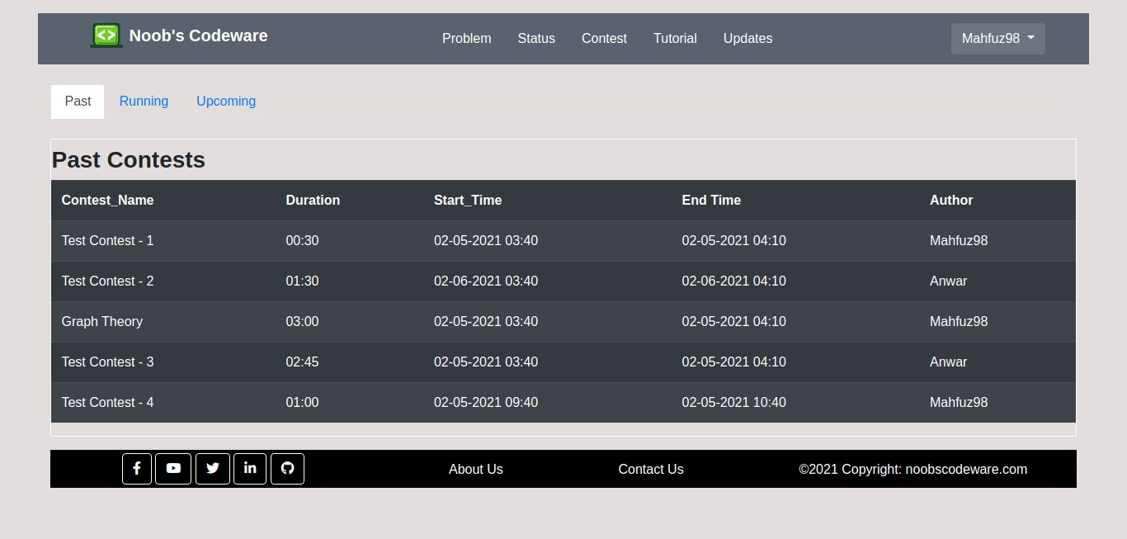
6.7 Contest
Fig 6.7: Contest
This is one of the most important features of our system. Users can also set contests.

Slide 33
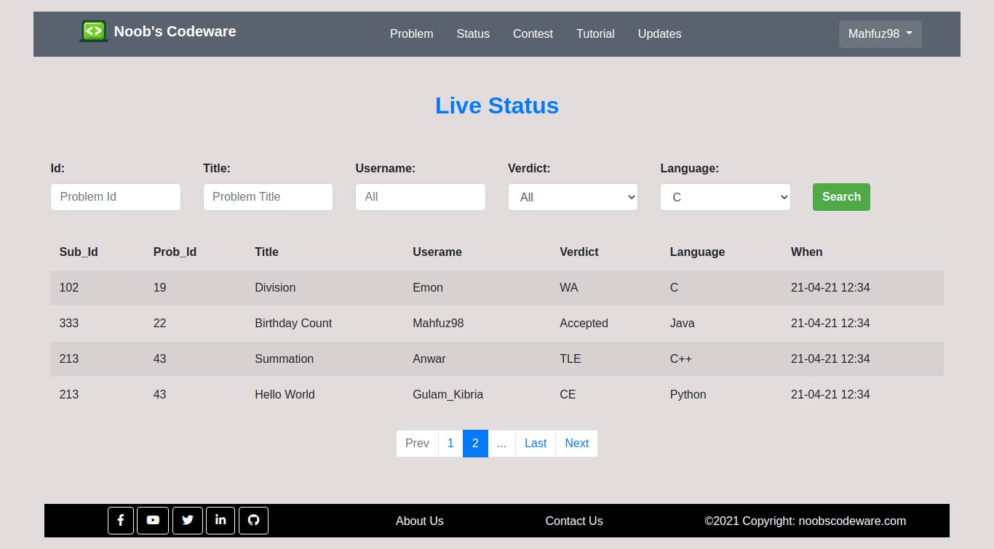
6.8 Live Status
Fig 6.8: Live status
The live status page shows the submission history for all the users. Users can filter out a submission according to the need.

Slide 34
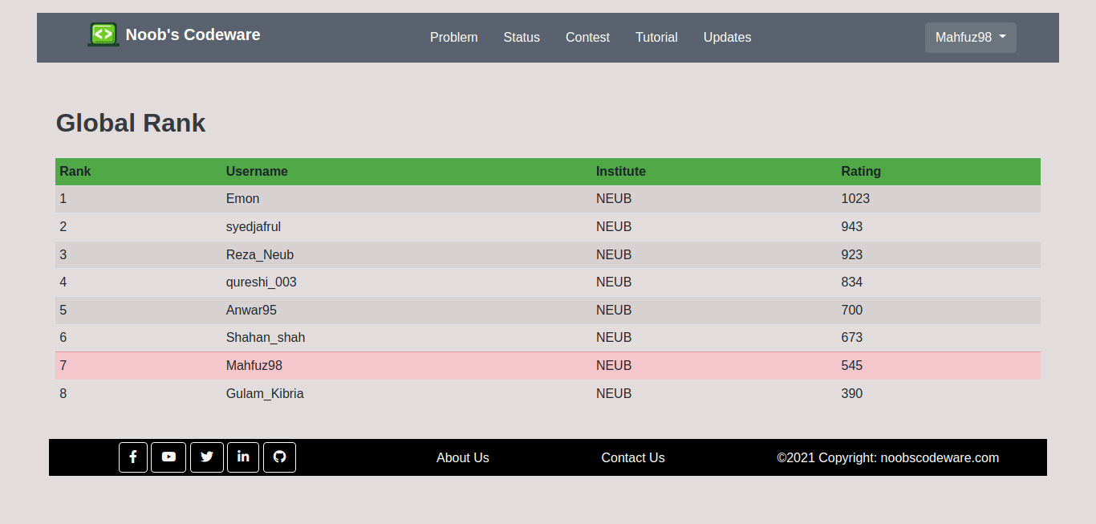
6.9 Global Rank
Fig 6.9: Global rank
This page shows the overall ranking for all the users according to their rating.

Slide 35
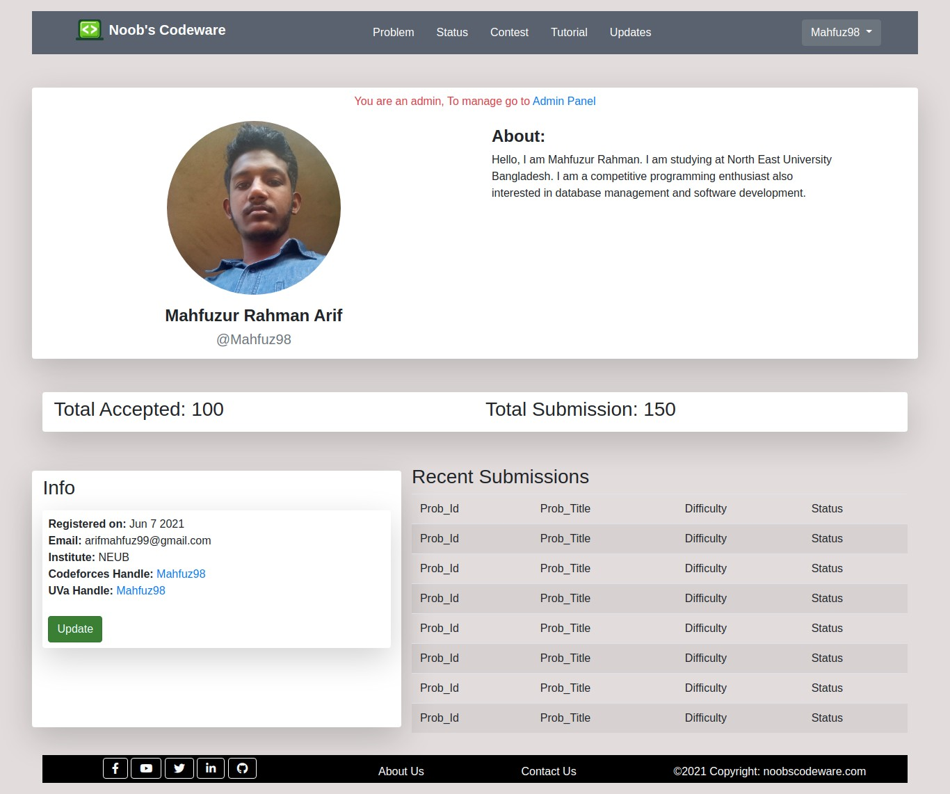
6.10 Profile
Fig 6.10: Profile
User profiles contain all the information about a user. It also contains the recent submission history, submission, and acceptance rates.

Slide 36
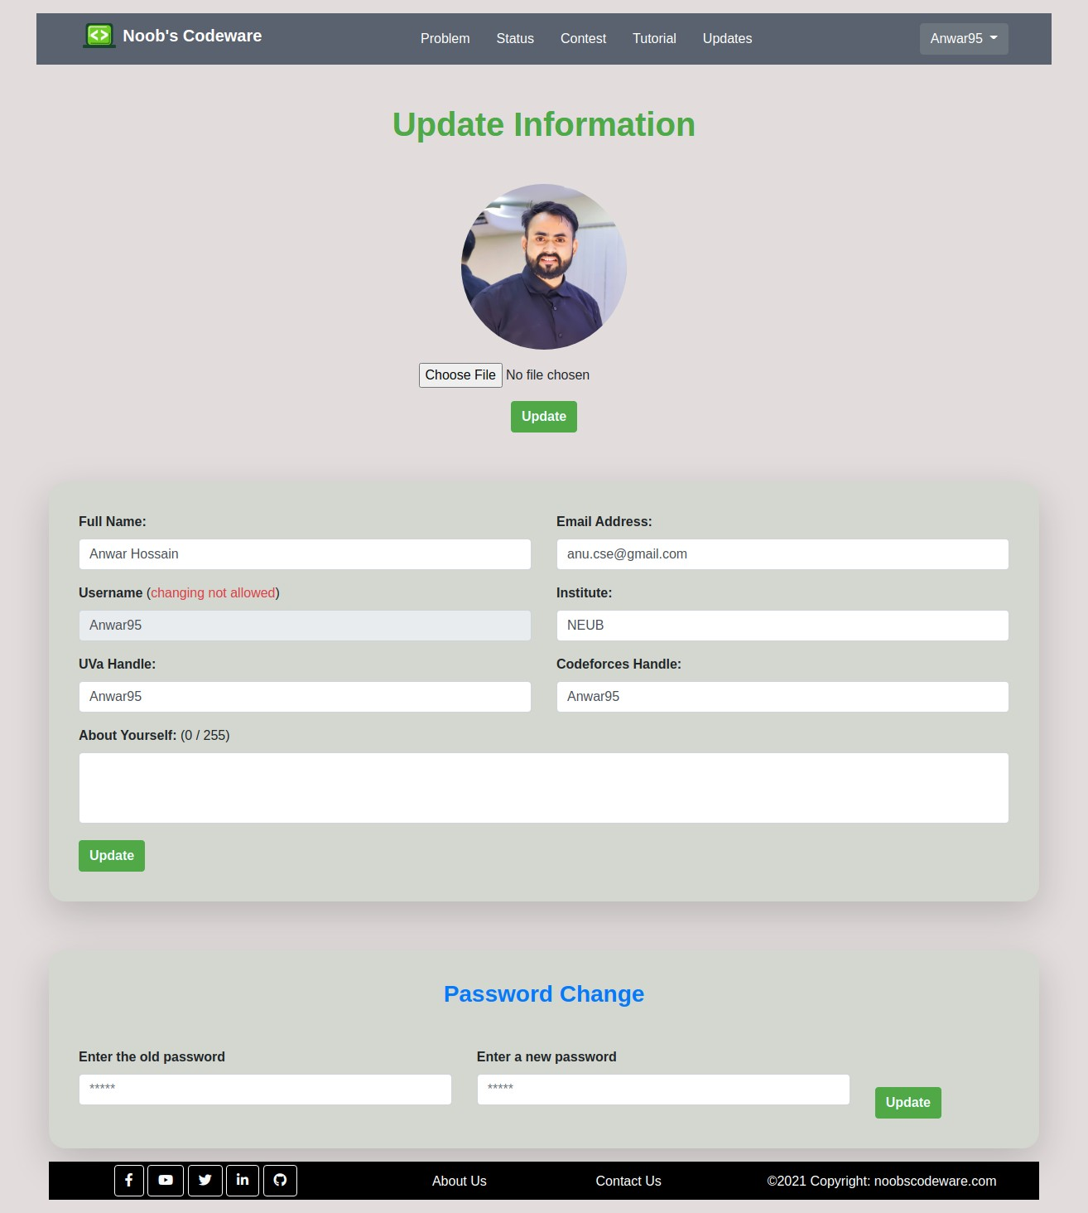
6.11 Update Profile
Fig 6.11: Update profile
Users can update the current information, profile picture, or password as well through this page.

Slide 37
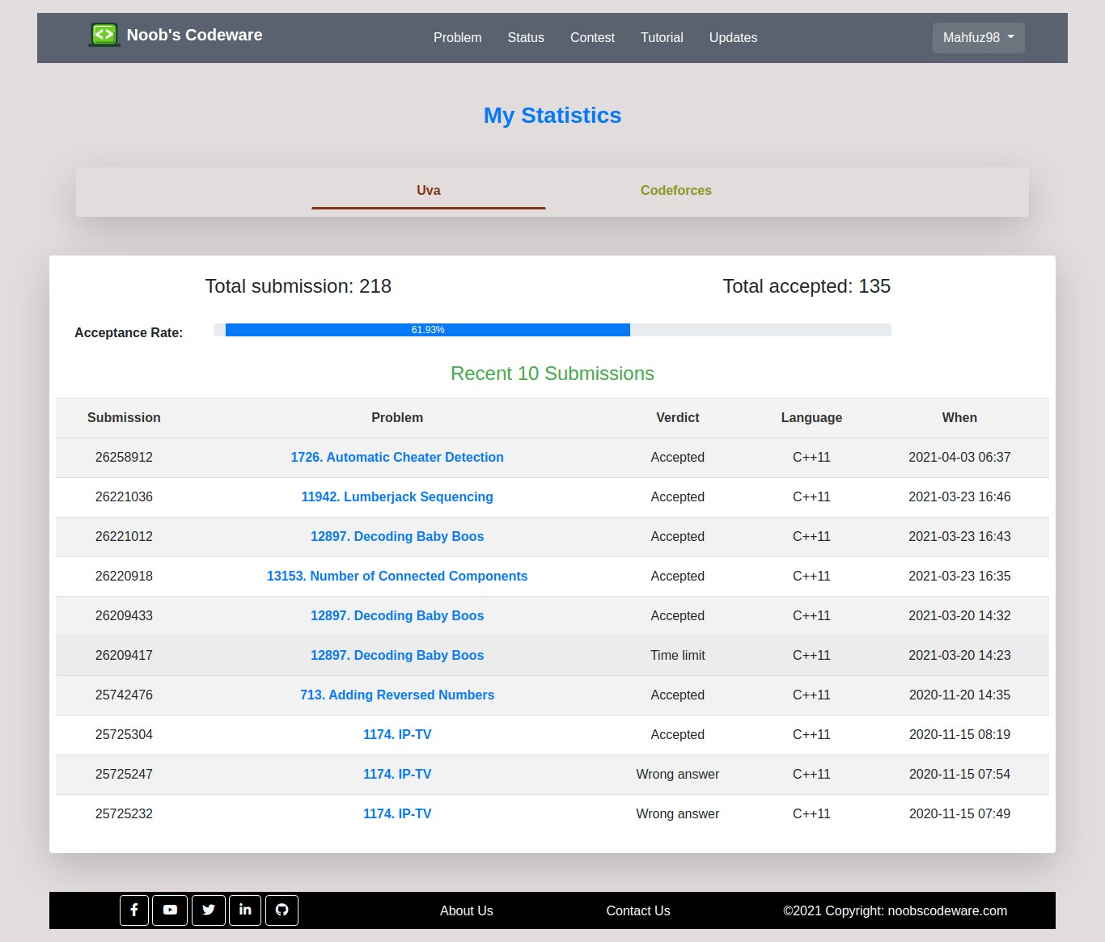
6.12 Other Online Judge Statistics
Fig 6.12: Other OJ statistics
Along with our own judge, users can ensure their codeforces and uva username to be updated with the statistics of these two judge.

Slide 38
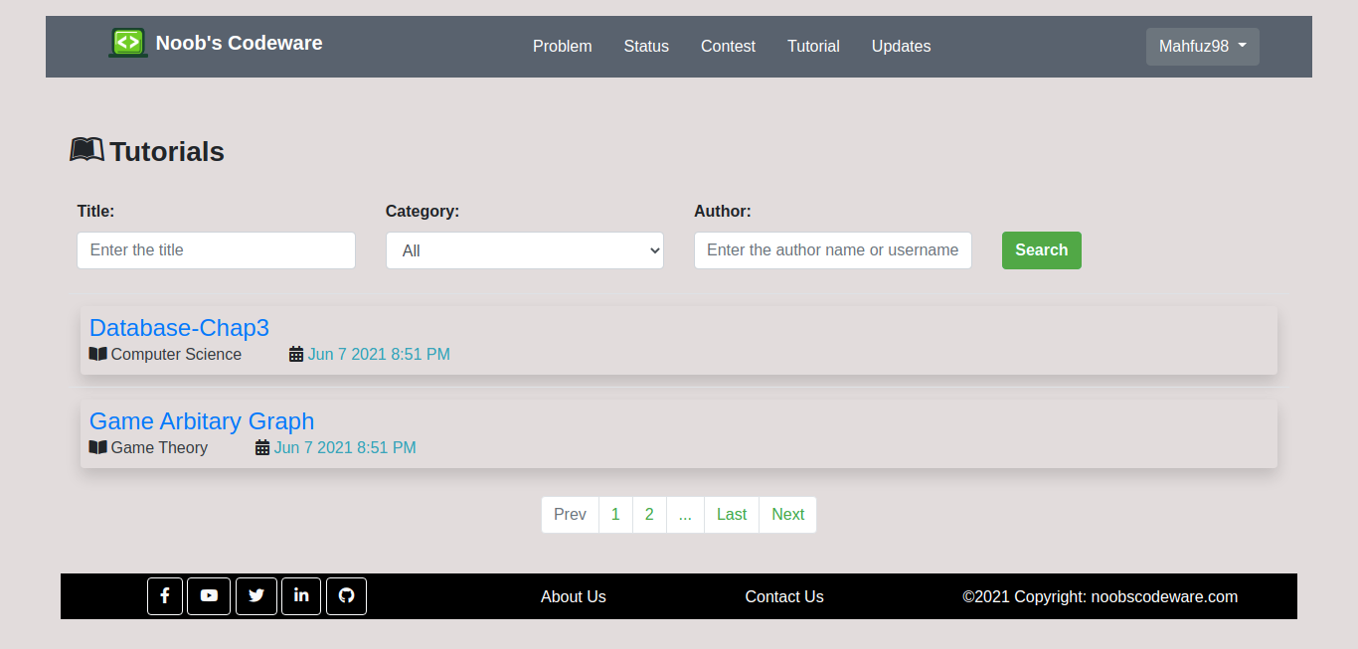
6.13 Tutorial
Fig 6.13: Tutorial
This is an additional and important feature of our system. User can filter out categorized tutorial as he needs and also can download the tutorial along reading directly on the webpage.

Slide 39
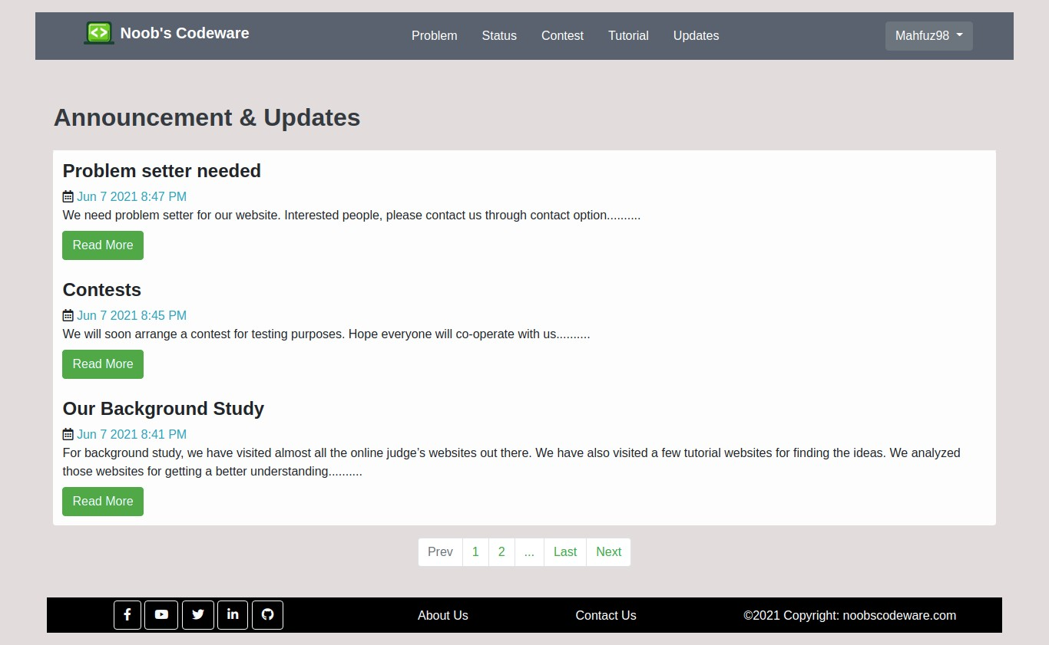
6.14 Updates
Fig 6.14: Updates
A user can check and get all the latest updates and announcements through the section. It is very helpful when an an important message arrives or gets to know about the next contests.

Slide 40
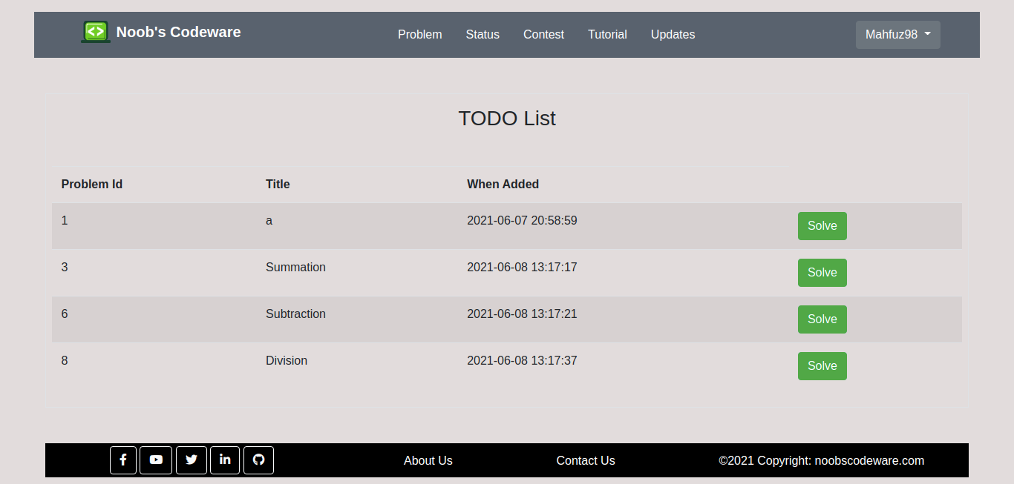
6.15 Todo List
Fig 6.15: Todo list
This is one of the most valuable features of our system. A user can add a problem to the todo list instead of solving it and later can access the problem through the list easily.

Slide 41
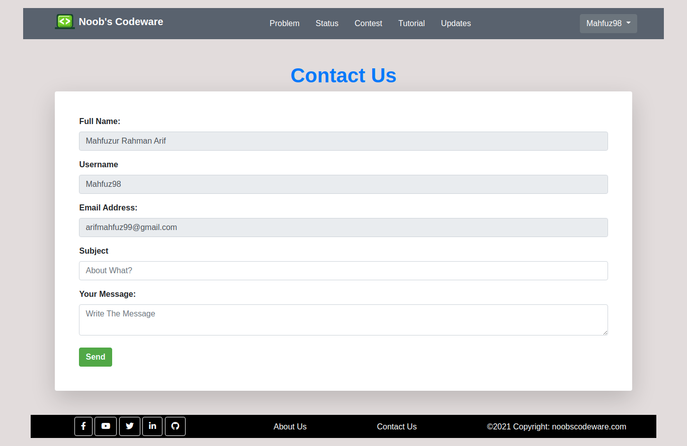
6.16 Contact Us
Fig 6.16: Contact us
Users can contact us through this mail system messaging. Instead of using the traditional mailing, it is easier for the users to get in touch with us.

Slide 42
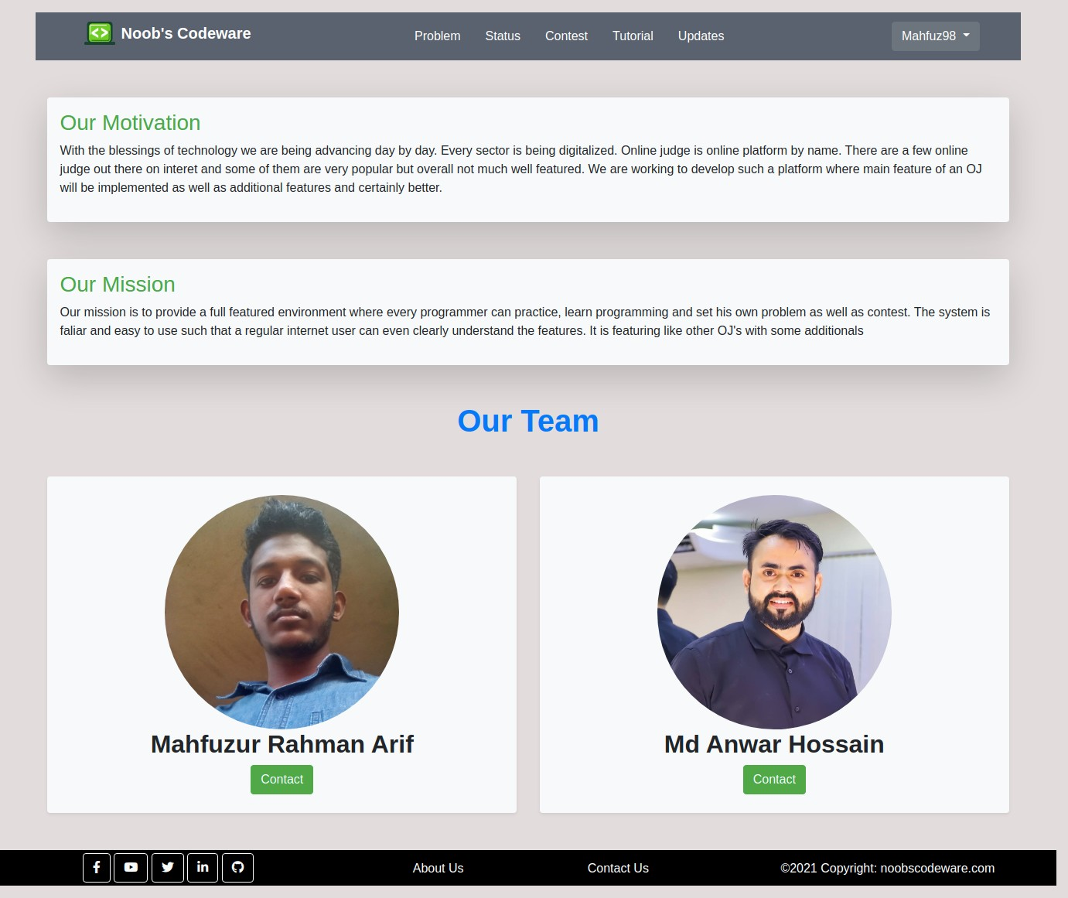
6.17 About Us
Fig 6.1: About us
This is our about us page containing the information of developers, the mission, and the motivation of our project.

Slide 43
Chapter 7
TOOLS USED
Overview
Hardware
Laptop
Smartphone
Operating System
Ubuntu 20.04
Windows 10
Software:
Visual Studio Code
Sublime Text
Google Chrome
Microsoft Edge
LAMP(Ubuntu)
XAMPP(Windows)
Language
HTML
CSS
Javascript
PHP
Mysql
C, C++, Java, and Python for testing purpose
Bash Commands
Compatibility
This application is compatible with all computers (Laptop / Desktop) which have Ram 2 GB, ROM 32 GB or above, and all mobile or tablet devices with 768MB Ram, 2GB ROM or above.

Slide 44
Chapter 8
FUTURE WORKS
Completing the back end.
Implementing the Compiler API.
Updating the front-end design according to the back end.
Updating the database entity attributes if needed.
Making the user interface more interactive.
Ensuring the system is error-free.

Slide 45
Chapter 9
CONCLUSION
This is a web application developed for the enthusiast competitive programmer who is passionate about learning, practicing programming problems, and also eager to arrange contests, set problems for others. Users can also request to set a problem or to publish a tutorial. The update section is a very useful feature through which users are regularly up to date with the latest news, announcements.
We hope, we can complete the full project implementing all the features with the back end.

Slide 46
REFERENCES
https://codeforces.com
h ttps://vjudge.net
h ttps://www.stopstalk.com
h ttp://cp-algorithms.com
h ttps://www.shafaetsplanet.com
h ttps://app.diagrams.net
h ttps://www.php.net/manual/en/index.php
h ttps://getbootstrap.com
h ttps://creately.com
h ttps://www.db-book.com/db6/slide-dir/index.html

